Slide 1
AutoScout Marketplace Conversion and Monetization Analytics

Slide 2
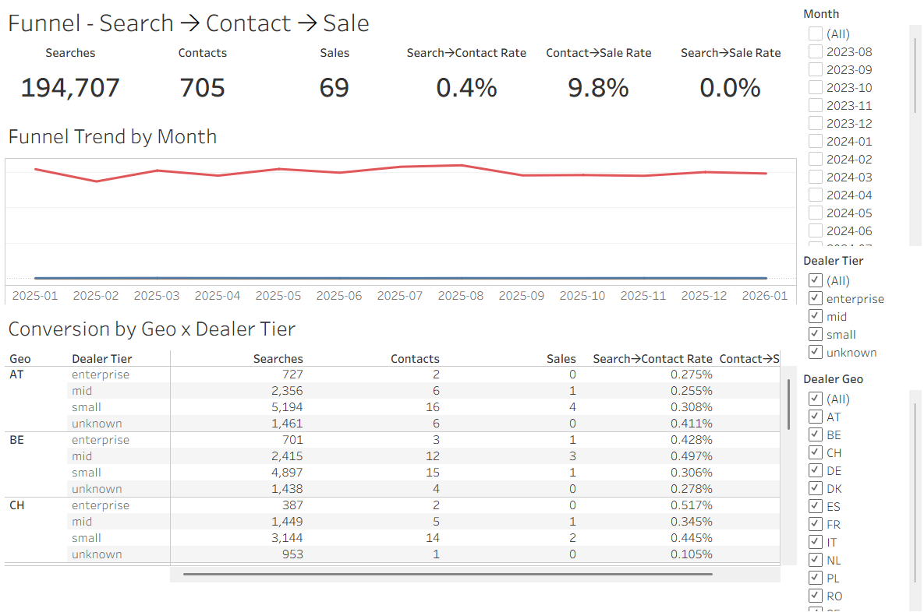

Slide 3
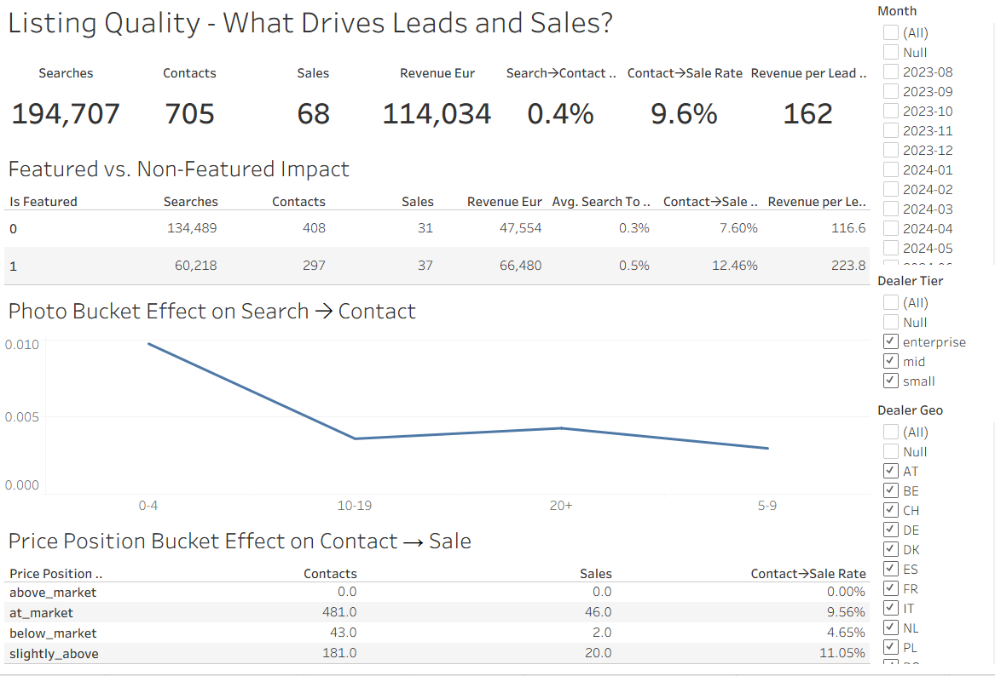

Slide 4
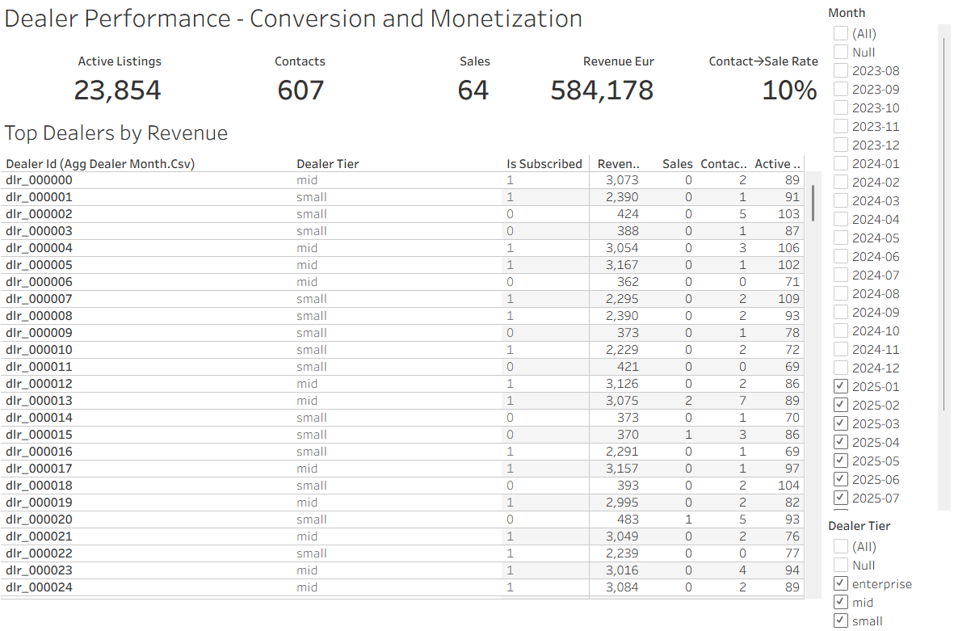

Slide 5
